Slide 1

ANALYSIS :
SALES DATASET

Slide 2
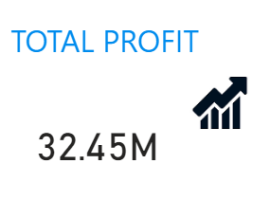
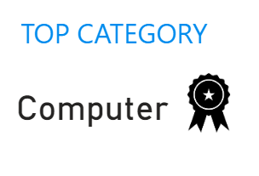

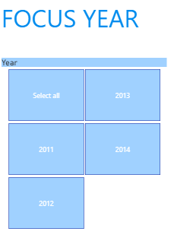
EXECUTIVE SUMMARY

Slide 3
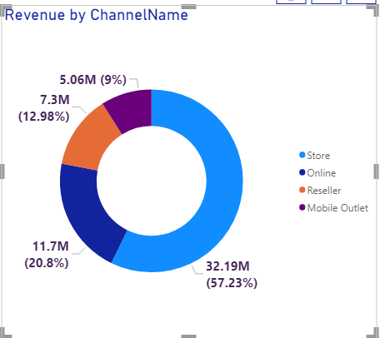
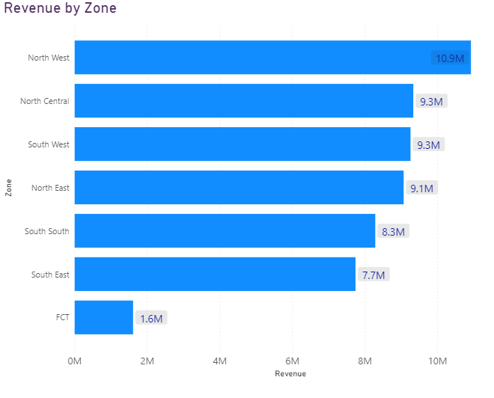
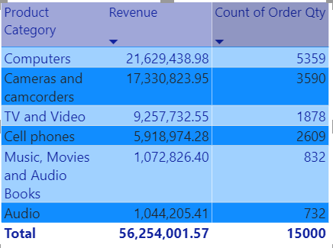
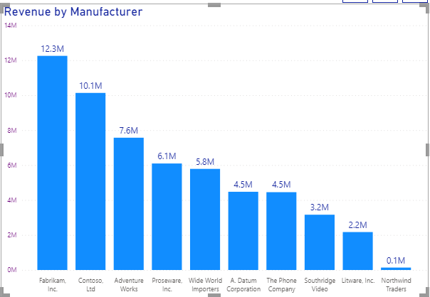
North west with the highest revenue generated 10.9M compared to FCT with 1.6M. Fabrikam Inc. made the most sales resulting in 12.3M Store Channel accounted for the highest sales generated. Audio category produced the least revenue compared to Computers with the best sale of 21.63M
Key Insights

Slide 4
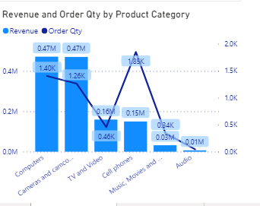
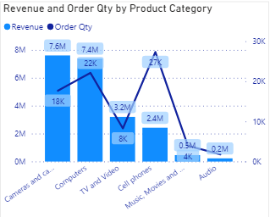
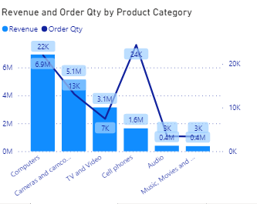
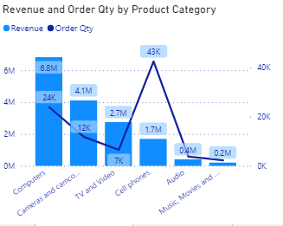
Across the years, cell phones had higher orders but less revenue compared to TV and Videos which had lower orders but more revenue Generally, there was a drastic rise in revenue generation for products between 2011 and 2012 Audio, Music, Movies and Audio Books generated the least revenue over the years
Key Insights

Slide 5
Key Products that drive Performance
Computers, Camera/Camcorders &
TV/Videos are the top products and key drivers of Performance
Music, Movies and Audio Books are two products that can be discontinued due to poor performances.

Slide 6
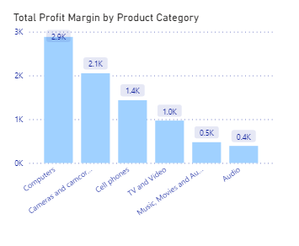
Computers had the highest profit margin with 2888.15 Audio generated the lowest profit margin with 391.12
Key Insights

Slide 7
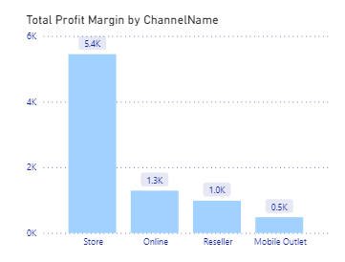
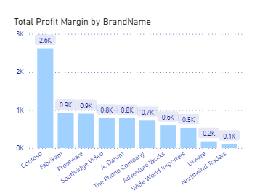
Store Channel accounted for the highest profit margin compared to the rest of the channels with Mobile Outlet generating the least Contoso Brand made the most contribution with the highest profit margin when compared with other Brand names.
Key Insights

Slide 8
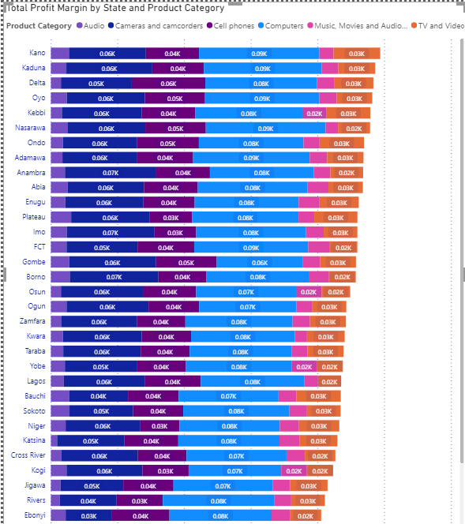
Kano State had the highest profit margin while Akwa Ibom had the least contribution for profit margin. Computers generated the most to each states’ profit margin with Cameras and Camcorders coming closely behind. Audio had the least contribution to each states’ profit margin
Key Insights

Slide 9
Create more store channels in FCT zone (low sales) to increase revenue Cut off brands having low sales to reduce maintenance costs Increase awareness for other brands (online & mobile outlet) to drive revenue Improve customer relationship to retain customer base in the coming year Roll out promotions to low product categories such as audio in order to boost sales A monthly shelf review should be done so that sold out products are restocked in a timely fashion Overall, revenue generated in the few years under review improved overtime. However, with the recommendations provided, there’s an opportunity for development and breakdown of analysis shows that current Administration is on the right trajectory
Recommendations
and
Conclusion

